Slide 1
CSET301 – AI-ML
Lecture 3 : Linear Regression

Slide 2
Linear Regression: Introduction
A supervised learning algorithm used for predicting a continuous target variable.
Models a functional relationship between a dependent variable (y) and one or more independent variables/features (x_{i}).
E.g. To test the strength of the relationship between amount of ice-cream eaten (independent variable) and obesity (dependent variable).
A regression equation is often used to predict a value of Y for a given value of X

Slide 3
Linear Regression: Introduction
Dependent and Independent variable
Independent variables/features are regarded as inputs to a system and may take on different values freely
Dependent variables are those values that change as a result of changes in other values in system
Independent variables are also known as predictor/explanatory variable, denoted by X.
Dependent variable is also known as response/target variable, denoted by y.

Slide 4
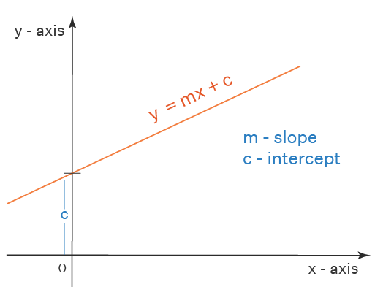

Linear Regression
Linear model: Assumes linear relationship between input variables and a single output variable (y).
Equation of straight line

Slide 5
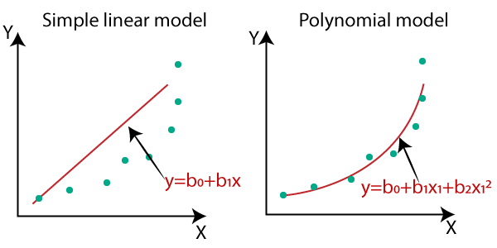
Linear Regression
Simple Linear Regression: single input variable (x)
y = Dependent variable
x = independent variable
β₀ = y intercept
β₁ = slope of line
ε = error variable

Slide 6
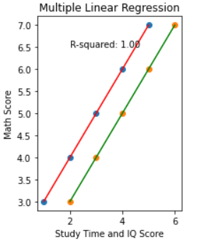
Linear Regression
Multiple Linear Regression: multiple input variables (x₁, x₂, …, x_{n})
y = β₀ + β₁x₁ + β₂x₂ + … + β_{n}x_{n} + ε
Polynomial Linear Regression: uses polynomial terms (x², x³, etc.). In below equation, n is the degree of polynomial
y = β₀ + β₁x₁ + β₂x₁² + … + β_{n}x₁^{n} + ε

Slide 7
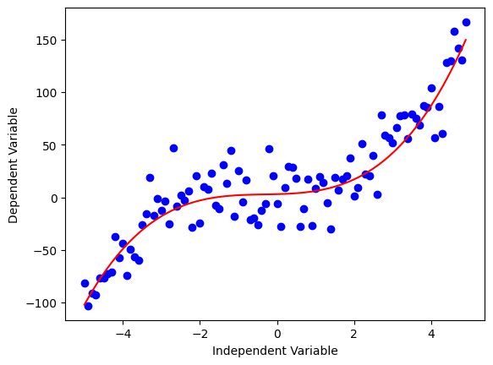
Linear Regression
Non-Linear Regression: relationship between variables is non-linear
y = β₀ / (1 + β₁ exp(β₂x₁)) + ε

Slide 8
Linear Regression: Introduction
Linear regression models a dependent variable, y as a function of some independent variables (aka "features"), x_{i} , by finding a line (or surface) that best "fits" the data.
For example:
Predicting the price of a house using the number of rooms in that house (y: price, x₁​: number of rooms)
Predicting weight from height and age (y: weight, x₁​: height, x₂​: age).

Slide 9
Linear Regression: Introduction
Equation for linear regression:
y = β₀ + β₁x₁ + β₂x₂ + … + β_{n}x_{n} + ε
y : dependent variable
x_{i} : input features
β_{i} : Coefficients/weights
ε : error

Slide 10
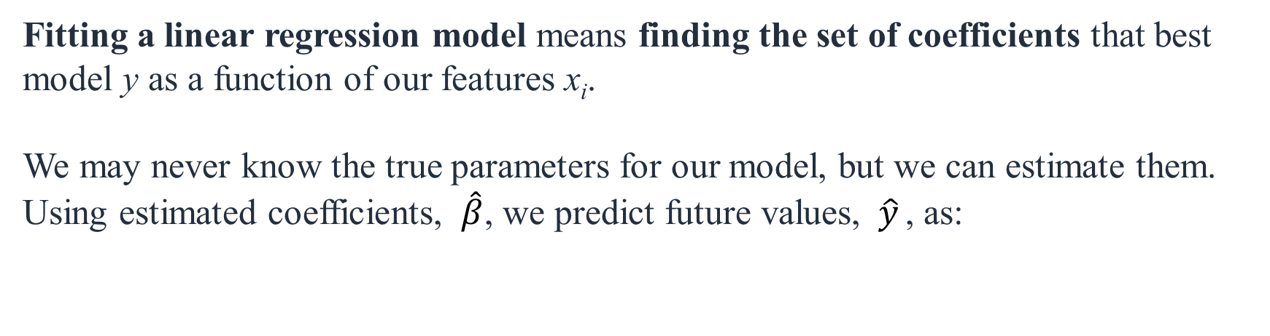
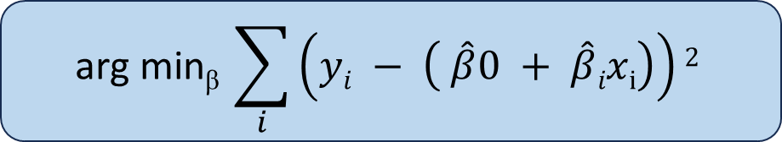
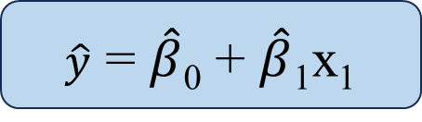
Linear Regression: Introduction
Fitting a linear regression model means finding the set of coefficients that best model y as a function of our features x_{i}.
We may never know the true parameters for our model, but we can estimate them. Using estimated coefficients, $\hat{β}$, we predict future values, $\hat{y}$ ​, as:
$\hat{y}$ = $\hat{β}$₀ + $\hat{β}$₁x₁
Goal: to estimate β from a training data of <x_{i}, y_{i}> pairs.
Optimization goal: minimize squared error (least squares method or sum of squared error (SSE) method)
$$\text{arg} \text{min}\text{β} \sum_{i}{\left(yi − \left( \hat{β}0 + \hat{β}ixi\right)\right)2}$$

Slide 11
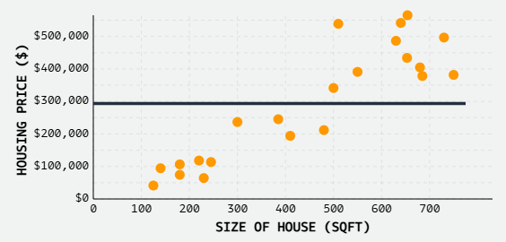
Linear Regression:
Let’s say you have data points
((x₁,y₁), (x₂,y₂), (x₃,y₃), …)
for housing price prediction where x is size of house in square foot, and y is house price.
Let's fit a model to predict housing price:
house-price = β0​^ + β1​^​∗sqft​
We'll start with a very simple model, predicting the price of each house to be just the average house price in our dataset, ~$290,000, ignoring the different sizes of each house:
house-price = 290000 + 0∗sqft
Ref: https://mlu-explain.github.io/linear-regression/

Slide 12
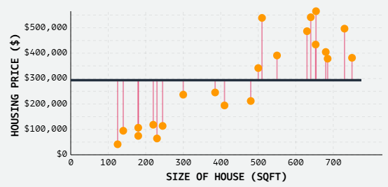
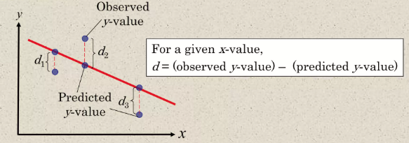
Linear Regression:
We know this model is bad - the model doesn't fit the data well at all. But how can do quantify exactly how bad?
At this point, to evaluate our model's performance quantitatively, we plot the error or residual of each observation directly.
Errors: measure the distance between each observation and the predicted value for that observation.
Error/Residual

Slide 13
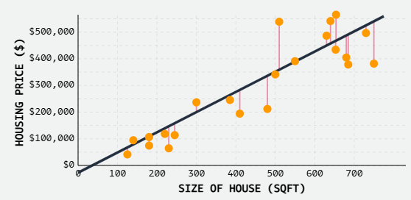
Linear Regression:
The goal of linear regression is to find a regression line (line of best fit), which is the line for which the sum of squares of the residuals is a minimum.
For our problem, the best fit line is shown. There's still error, sure, but the general pattern is captured well.
As a result, we can be reasonably confident that if we plug in new values of square-foot, our predicted values of price would be reasonably accurate.

Slide 14
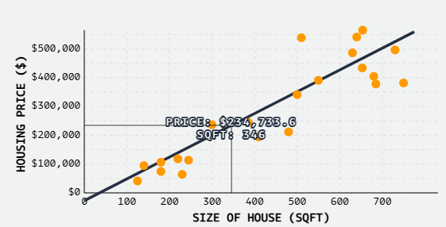
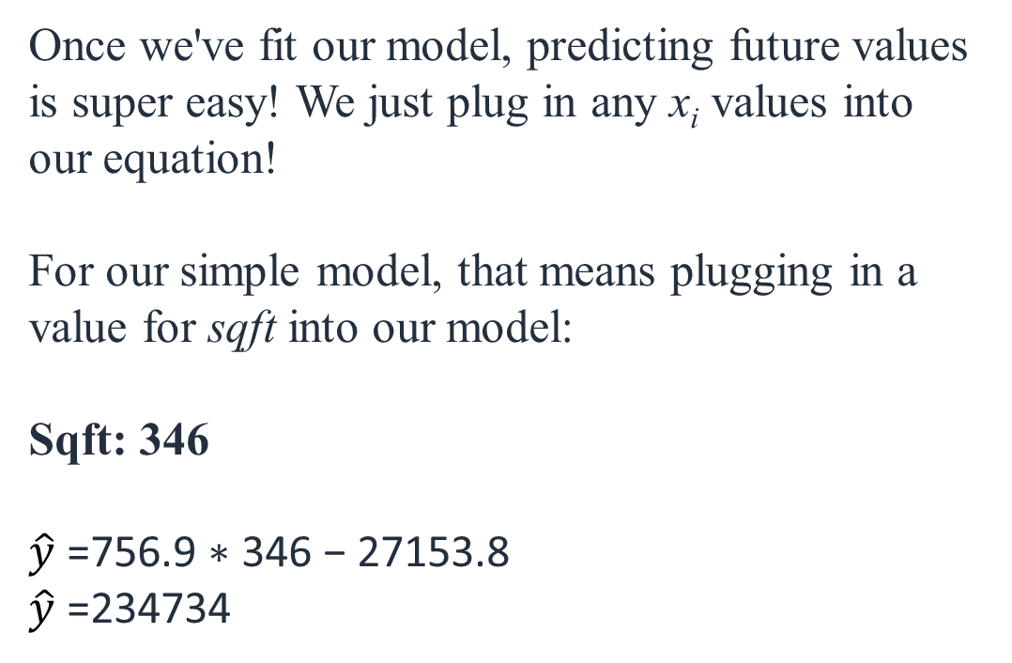
Linear Regression:
Once we've fit our model, predicting future values is super easy! We just plug in any x_{i}​ values into our equation!
For our simple model, that means plugging in a value for sqft into our model:
Sqft: 346
$\hat{y}$ ​=756.9 ∗ 346 − 27153.8
$\hat{y}$ =234734

Slide 15

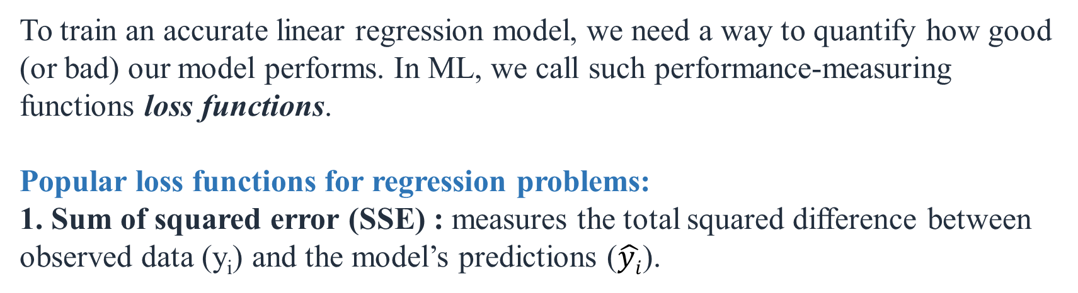
Linear Regression: Model Evaluation
To train an accurate linear regression model, we need a way to quantify how good (or bad) our model performs. In ML, we call such performance-measuring functions loss functions.
Popular loss functions for regression problems:
1. Sum of squared error (SSE) : measures the total squared difference between observed data (y_{i}) and the model’s predictions ($\hat{yi}$).
Least Square method is a mathematical technique used to find the best-fitting line (or model) by minimizing the sum of squared errors.

Slide 16

Linear Regression: Model Evaluation
Popular loss functions for regression problems:
2. Mean-Squared Error (MSE) : Quantifies how close a predicted value is to the true value.
Normalized version of SSE
The squaring of errors prevents negative and positive terms from canceling out in the sum.
Penalizes large errors more than small ones (due to squaring) - by giving more weight to points further from the regression line (i.e., punishing outliers)
Differentiable

Slide 17

Linear Regression: Model Evaluation
Popular loss functions for regression problems:
3. R-Squared (goodness-of-fit measure) : summarize how well a model fits a set of data. It represents the percentage of the variance in y explained by our features x.
Specifically, it measures the percentage of variance explained normalized against the baseline variance of our model (which is just the variance of the mean).
The highest possible value for r-squared is 1, representing a model that captures 100% of the variance. A negative r-squared means that our model is doing worse (capturing less variance) than a flat line through mean of our data would.

Slide 18
Linear Regression: Demo
https://www.geogebra.org/m/FUe3HfRf

Slide 19
Linear Regression: Applications
Predicting house prices
Risk assessment in finance
Sales forecasting
Predicting disease progression using biomarkers

Slide 20
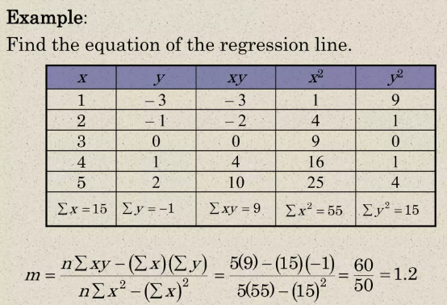
Linear Regression: Example

Slide 21
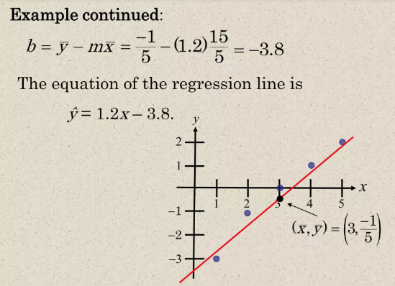
Linear Regression: Example

Slide 22


Simple Linear Regression: Solving by Hand
X | Y
1 | 2
2 | 3
4 | 5
3 | 4
5 | 7
We want to fit a line of form: y = mx+c
Formula for calculating Slope m :
Formula for calculating intercept b :

Slide 23
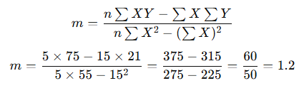
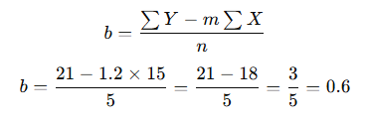
Simple Linear Regression: Solving by Hand
Putting in values in m and b formula:
X | Y | XY | X²
1 | 2 | 2 | 1
2 | 3 | 6 | 4
4 | 5 | 20 | 16
3 | 4 | 12 | 9
5 | 7 | 35 | 25
15 | 21 | 75 | 55
Σ
Final regression line: y = 1.2x + 0.6

Slide 24
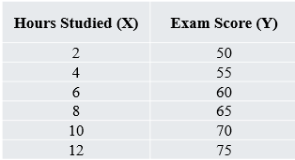
Linear Regression: Practice Problem
Question: An analyst is studying the relationship between hours studied (X) and exam scores (Y) among students. The data collected is:
Task: Calculate the slope (m) and intercept (b) of the regression line and interpret their meanings.

Slide 25
Thank You

